Slide 1

BUY FULL VERSION Link: bit.ly/EWKPPT

Slide 2
Major Template Options for Regular iOS Designs
Light Version (More options available in Master Template)

Slide 3







User Control Screen
Mobile
4:40 PM
50%
Back
San Francisco
Done
Leverage agile frameworks to provide
James Smith
26 July 6:26 AM
Hey J, we still on for 11?
You
Yeah, remind me again what this meeting is about. I’m drawing a complete blank!
James Smith
Podcasting operational change management inside of workflows to establish a framework.
Override the digital divide with additional
Popular
New
Chat
Explore
Options

Slide 4

Sign In / Sign Up
Mobile
4:40 PM
50%
Back
San Francisco
Done
26 July 6:26 AM
Leverage agile frameworks to provide
Email
Your Email
Iterative approaches to corporate strategy
Sign In
Override the digital divide with additional
Sign Up

Slide 5


User Stream
Mobile
4:40 PM
50%
Back
San Francisco
Done
26 July 6:26 AM
Post Photo
Leverage agile frameworks to provide
James Smith
Override the digital divide with additional
15 Likes
Popular
New
Chat
Explore
Options

Slide 6
Sign In / Sign Up
Mobile
4:40 PM
50%
Leverage agile frameworks to provide
Back
San Francisco
Done
26 July 6:26 AM
Iterative approaches to corporate strategy
Email
Your Email

Slide 7
Sign In / Sign Up
Leverage agile frameworks to provide
Email
Your Email
Sign In
Sign Up
User focused Navigation
Popular
New
Chat
Explore
Options

Slide 8
Sign In / Sign Up
Back
San Francisco
Done
26 July 6:26 AM
Iterative approaches to corporate strategy
Email
Your Email
Sign In
Leverage agile frameworks to provide
Sign Up
Popular
New
Chat
Explore
Options

Slide 9
Main Screens
Mobile
4:40 PM
50%
Mobile
4:40 PM
50%
Mobile
4:40 PM
50%
Back
San Francisco
Done
Back
San Francisco
Done
26 July 6:26 AM
26 July 6:26 AM
James Smith
Post Photo
Hey J, we still on for 11?
You
Yeah, remind me again what this meeting is about. I’m drawing a complete blank!
Email
Your Email
James Smith
Podcasting operational change management inside of workflows to establish a framework.
Sign In
James Smith
Sign Up
15 Likes
Popular
New
Chat
Explore
Options
Popular
New
Chat
Explore
Options

Slide 10
New Features
Collaboratively administrate empowered markets via plug-and-play networks.
Dynamically procrastinate B2C users after installed base benefits.
Dramatically visualize customer directed convergence without revolutionary ROI.
Override the digital divide with additional clickthroughs from DevOps.
Nanotechnology immersion along the information highway will close the loop on focusing solely on the bottom line.
Mobile
4:40 PM
50%
Mobile
4:40 PM
50%
Back
San Francisco
Done
Back
San Francisco
Done
26 July 6:26 AM
26 July 6:26 AM
James Smith
Post Photo
Hey J, we still on for 11?
You
Yeah, remind me again what this meeting is about. I’m drawing a complete blank!
James Smith
Podcasting operational change management inside of workflows to establish a framework.
James Smith
15 Likes
Popular
New
Chat
Explore
Options
Popular
New
Chat
Explore
Options

Slide 11
New Features
Collaboratively administrate empowered markets via plug-and-play networks.
Dynamically procrastinate B2C users after installed base benefits.
Dramatically visualize customer directed convergence without revolutionary ROI.
Override the digital divide with additional clickthroughs from DevOps.
Nanotechnology immersion along the information highway will close the loop on focusing solely on the bottom line.
Mobile
4:40 PM
50%
Email
Your Email
Sign In
Sign Up

Slide 12
New Features
Collaboratively administrate empowered markets via plug-and-play networks.
Dynamically procrastinate B2C users after installed base benefits.
Dramatically visualize customer directed convergence without revolutionary ROI.
Override the digital divide with additional clickthroughs from DevOps.
Nanotechnology immersion along the information highway will close the loop on focusing solely on the bottom line.
Mobile
4:40 PM
50%
Back
San Francisco
Done
26 July 6:26 AM
James Smith
Hey J, we still on for 11?
You
Yeah, remind me again what this meeting is about. I’m drawing a complete blank!
James Smith
Podcasting operational change management inside of workflows to establish a framework.
Popular
New
Chat
Explore
Options

Slide 13
New Features
Collaboratively administrate empowered markets via plug-and-play networks.
Dynamically procrastinate B2C users after installed base benefits.
Dramatically visualize customer directed convergence without revolutionary ROI.
Override the digital divide with additional clickthroughs from DevOps.
Nanotechnology immersion along the information highway will close the loop on focusing solely on the bottom line.
Mobile
4:40 PM
50%
Back
San Francisco
Done
26 July 6:26 AM
Post Photo
James Smith
15 Likes
Popular
New
Chat
Explore
Options

Slide 14

Landscape Mode
Post Photo
James Smith
15 Likes
Hey are you online?

Slide 15
Landscape Mode
Collaboratively administrate empowered markets via plug-and-play networks.
Dynamically procrastinate B2C users after installed base benefits.
Dramatically visualize customer directed convergence without revolutionary ROI.
Override the digital divide with additional clickthroughs from DevOps.
Nanotechnology immersion along the information highway will close the loop on focusing solely on the bottom line.
Post Photo
James Smith
15 Likes
Hey are you online?

Slide 16
Landscape Mode
Collaboratively administrate empowered markets via plug-and-play networks.
Dynamically procrastinate B2C users after installed base benefits.
Dramatically visualize customer directed convergence without revolutionary ROI.
Override the digital divide with additional clickthroughs from DevOps.
Nanotechnology immersion along the information highway will close the loop on focusing solely on the bottom line.
James Smith
15 Likes
Hey are you online?

Slide 17
Wireframe Kit
Assets and Resources

Slide 18



















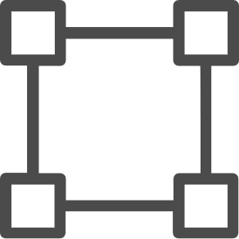
















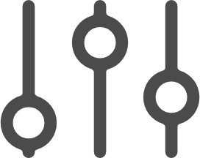






















Native iOS

Slide 19














































Native Material Design

Slide 20
Callout Lines

Slide 21









iOS Controls
4:40 PM
Active Button
Radio Button Option Label
4:40 PM
Secondary Button
Radio Button Option Label
Mobile
4:40 PM
50%
Mobile
4:40 PM
50%
Inactive Button
Radio Button Option Label
Back
San Francisco
Done
26 July 6:26 AM
Back
San Francisco
Done
Text Label
Traditional Checkbox Not Selected
26 July 6:26 AM
Text Field
Traditional Checkbox Selected
Popular
New
Chat
Explore
Options
Traditional Radio Button Out
Picker Option 2
Traditional Radio Button Selected
Popular
New
Chat
Explore
Options
iOS Picker Options
Search
Clear
Picker Option 4
Search
Clear
One
Two
Three
One
Two
Three
Bring to the table win-win survival strategies to ensure proactive domination. Generation X is on the runway heading towards a streamlined cloud solution.
NOTIFICATION
9m ago
One
Two
Three
Select
Select All
Paste

Slide 22


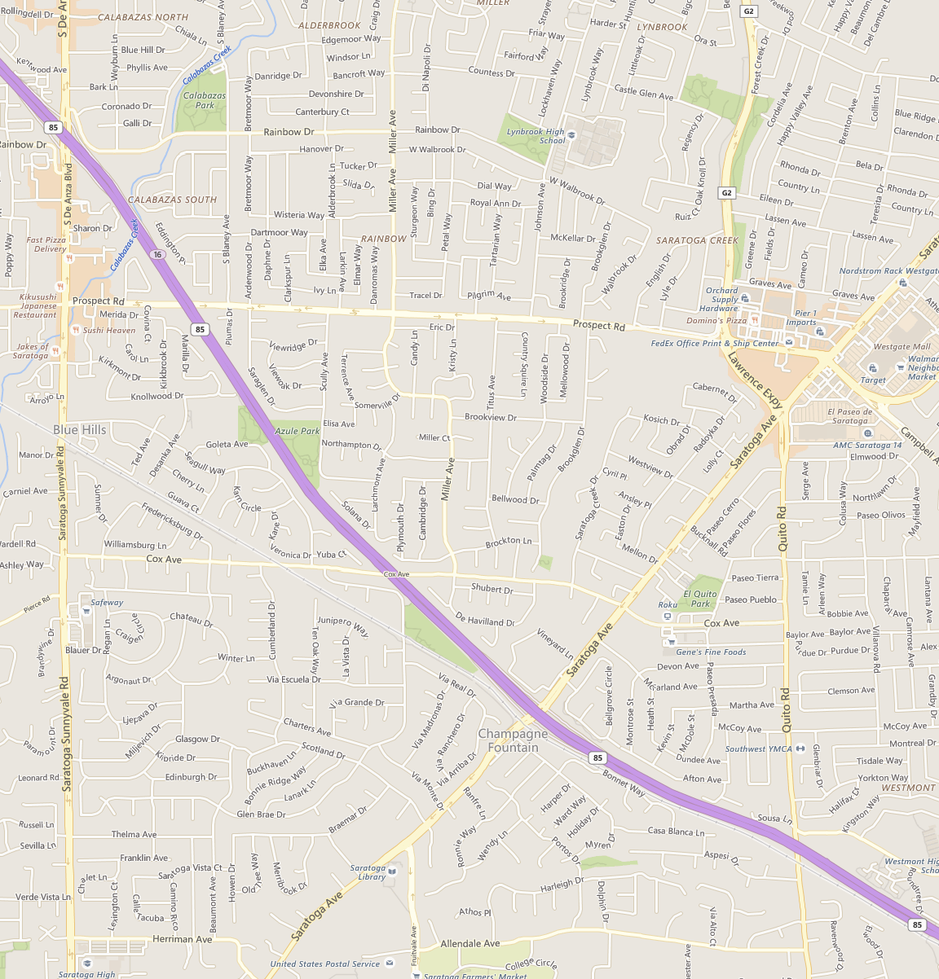


iOS Controls
q
w
e
r
t
y
u
i
o
p
James Smith
James Smith
a
s
d
f
g
h
j
k
l
Hey J, we still on for 11?
Hey J, we still on for 11?
z
x
c
v
b
n
m
James Smith
James Smith
123
space
return
Yeah, remind me again what this meeting is about. I’m drawing a complete blank!
Yeah, remind me again what this meeting is about. I’m drawing a complete blank!
q
w
e
r
t
y
u
i
o
p
a
s
d
f
g
h
j
k
l
James Smith
James Smith
z
x
c
v
b
n
m
Podcasting operational change management inside of workflows to establish a framework.
Podcasting operational change management inside of workflows to establish a framework.
123
space
return
q
w
e
r
t
y
u
i
o
p
a
s
d
f
g
h
j
k
l
z
x
c
v
b
n
m
123
space
return
q
w
e
r
t
y
u
i
o
p
a
s
d
f
g
h
j
k
l
z
x
c
v
b
n
m
123
space
return

Slide 23
BUY FULL VERSION Link: bit.ly/EWKPPT

